Slide 1

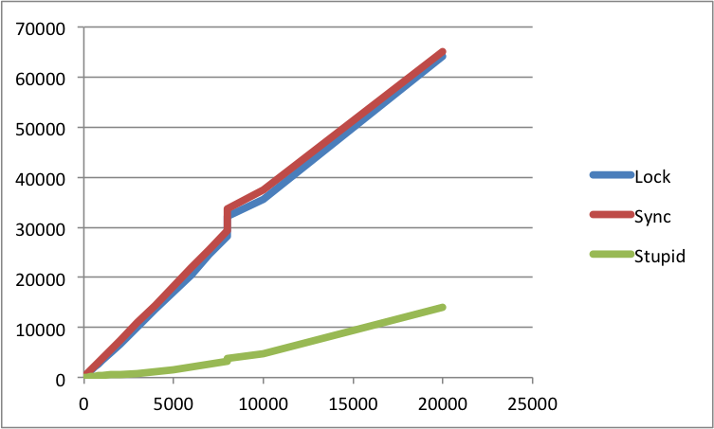
Approximate Computing by Relaxed Synchronization
Bashima Islam (1005095), Faysal Hossain (1005076)
Preserving Concurrency needs time
Relax Synchronization to achieve approximation
Interesting Findings
Unstable behaviour between
tryLock and Thread.sleep
tryLock and new Thread
Faster than lock but more accurate than stupid?
Allow some error:
Vast amount of data
Presence of outliers
Small effect of errors
100% accuracy not needed, no need to waste energy computing it.
Solution: Approximate Computing
Adaptive tryLock()
Challenges
Preserving Synchronization
Two methods
Synchronized
Lock
Choosing Lock over Synchronized
Guards shared resources
Addresses more complex scenarios
Implements all the features of synchronization
Allows timeout for thread to wait for lock
Provides interruptLock, tryLock and timeLock
Faster when large number of cores
Department of Computer Science and Engineering (CSE), BUET

